Slide 1

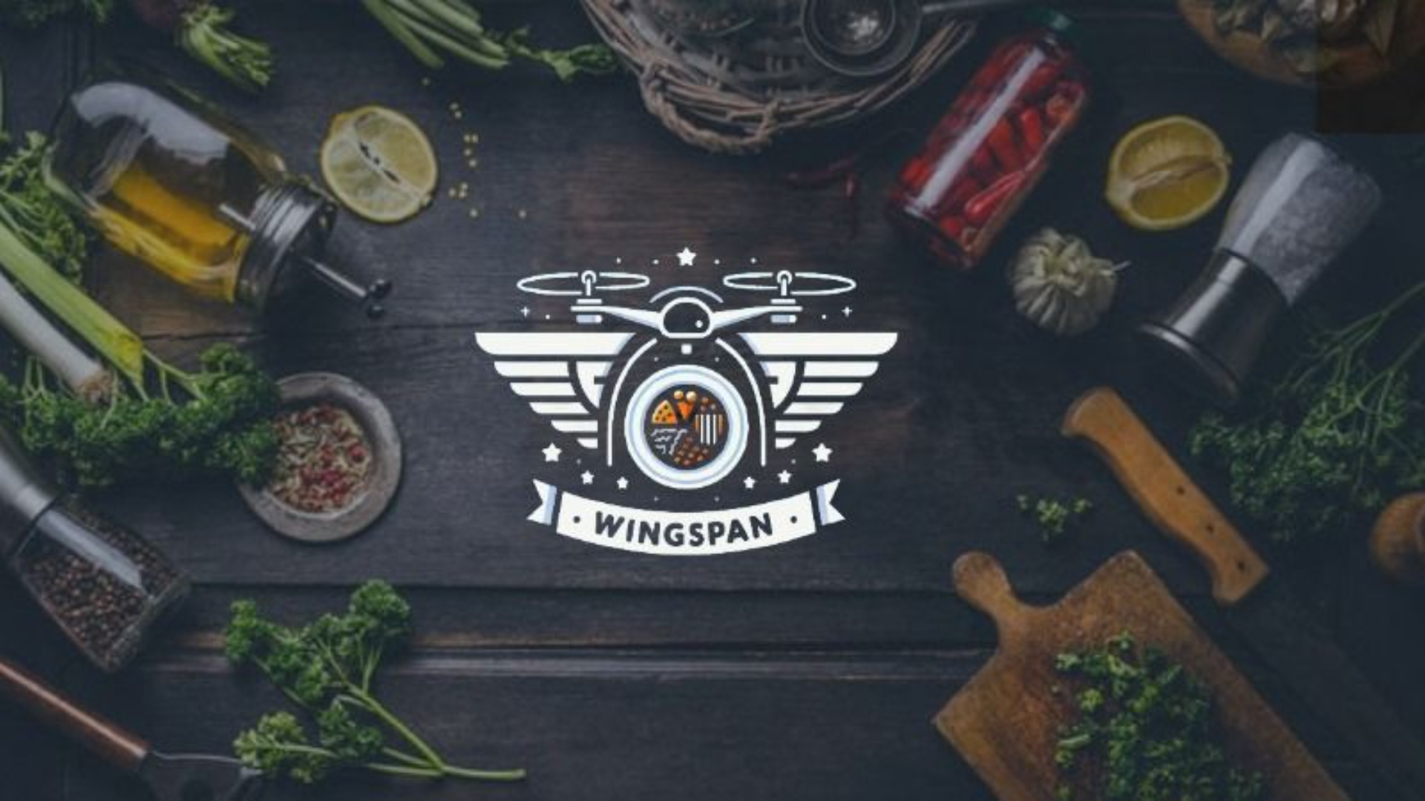
Presented by K. Sree Vaishnavi - 09
Ch. Bharath – 25
Ch. Manideep – 27
G. Harshith – 31
J. Sai Rithwik – 37
K. Sai Teja - 41

Slide 2

Problem Statement
1
Lengthy Queues
2
Inconvenient Ordering Process
3
Order Errors and Miscommunication
Students often encounter long waits in the canteen, causing delays in their daily activities.
The current method of ordering through traditional means is slow and doesn't suit the fast-paced lifestyle of students.
Manual order-taking can lead to mistakes, resulting in customer dissatisfaction and the waste of resources.

Slide 3

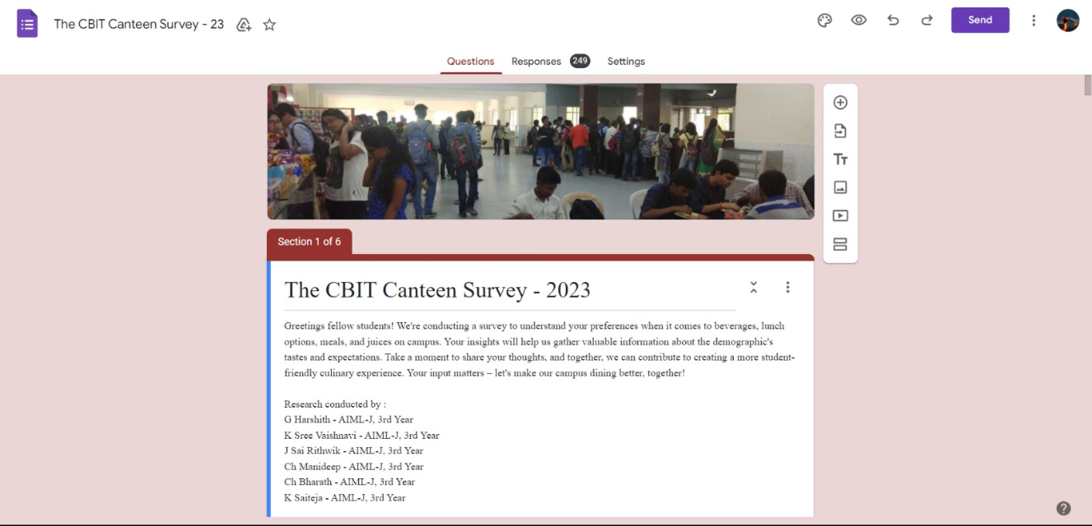
Market Analysis

Slide 4

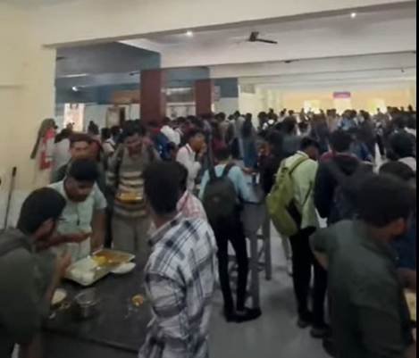
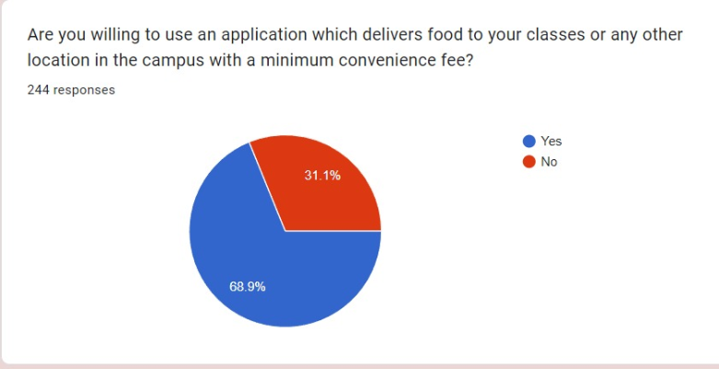
Target Customers

Slide 5
Marketing Strategies: Spreading the Word
1
Social Media Campaigns 🌐
2
Campus Ambassador Program 🎓
3
Partnerships with Student Clubs 🤝
We engage with students through captivating social media content, showcasing the convenience of our service through various social media platforms like Instagram, etc
By partnering with student clubs and organizations, we expand our reach and connect with our target audience.
We collaborate with influential student ambassadors to promote our platform and increase user awareness.

Slide 6
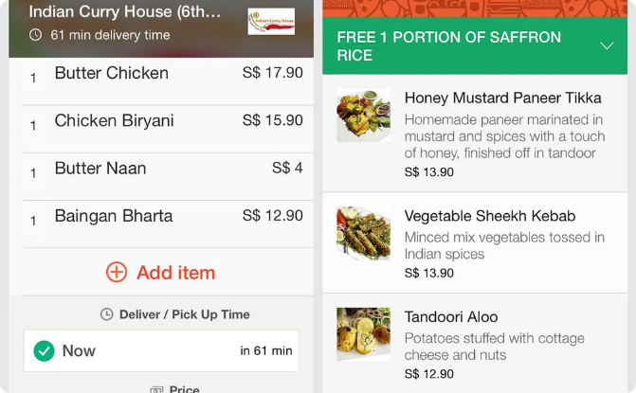
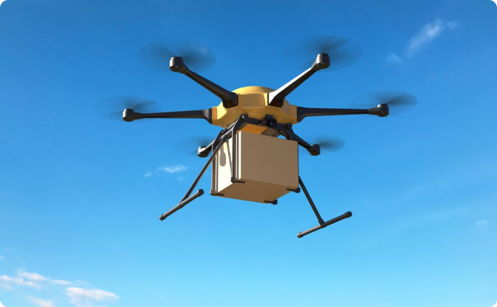
Methodology: Seamless and Efficient Food Ordering
Easy Online Ordering
Efficient Drone Delivery
Our user-friendly website enables students to place food orders from anywhere within the campus.
Utilizing drone technology, we ensure swift and accurate delivery, saving time and reducing human errors.

Slide 7

Project Execution: Transforming the Canteen Experience
1
Research & Planning
We conducted extensive market research to identify pain points and gather user feedback for our project.
2
Design & Development
Our team of skilled professionals created a user-friendly website and developed a seamless ordering and delivery system.
3
Testing & Refinement
We meticulously tested our platform to ensure smooth functionality, making necessary refinements along the way.
4
Launch & Promotion
Roll out our service, generating awareness among students through targeted marketing strategies and promotional events.

Slide 8

Steps: From Order Placement to Delivery
1. Browse and Select
2. Review and Confirm
3. Fast Drone Delivery
Students can explore the fooditems listed in our canteen menu and select their choice
Before placing the order, users have the opportunity to review their selections and make any necessary changes.
Once the order is confirmed, drones swiftly deliver the food items to the specified location within the campus.

Slide 9
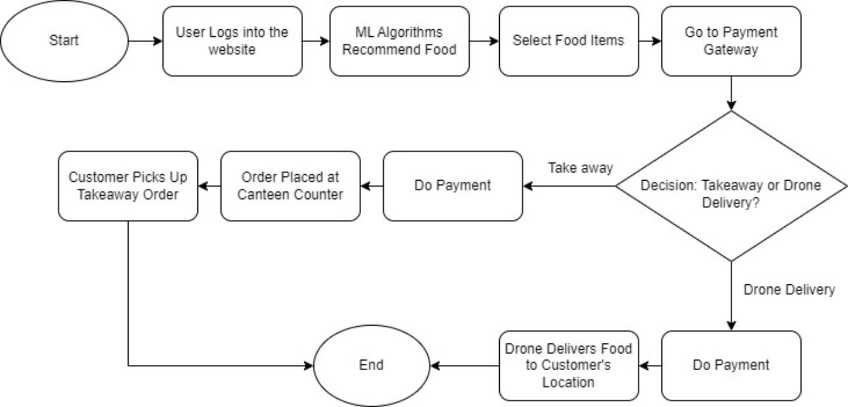
Work Flow

Slide 10

Competitors

Slide 11

Industry Overview: Navigating the Food Delivery Landscape
Rapid Growth 📈
Competitive Market 💼
The online food delivery sector has experienced substantial growth, with an increasing number of consumers preferring digital platforms.
Several key players are already operating in the food delivery industry, intensifying the competition for market dominance.
Changing Consumer Behavior 🍽
Technological Innovations 🚀
Shifts in consumer preferences have resulted in a greater demand for convenience, speed, and personalized experiences.
Advancements in technology, such as drone delivery, are revolutionizing the way food is ordered and delivered.

Slide 12
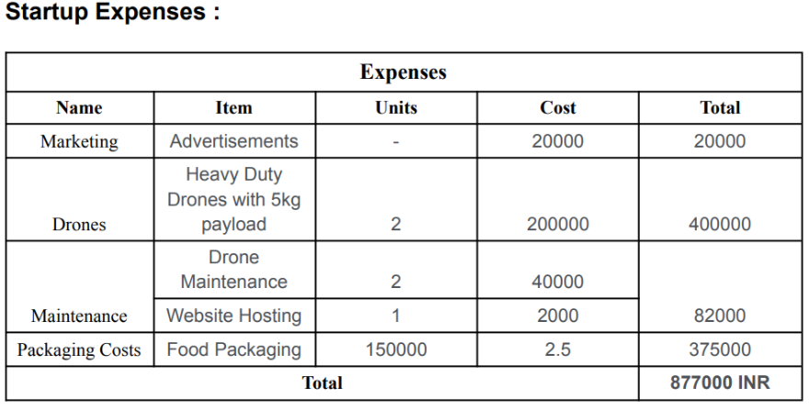
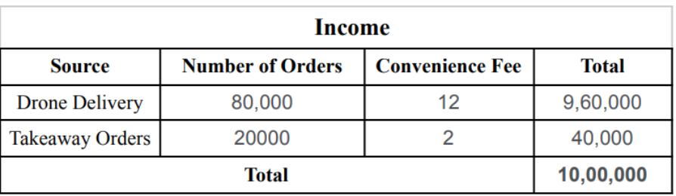
Pricing Structure: Affordable and Transparent

Slide 13



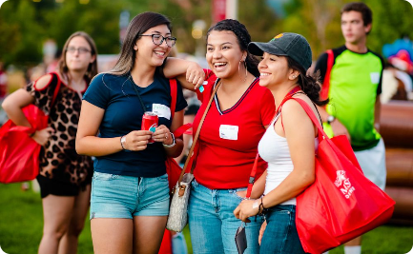
Future Scope
Expansion to Other Campus Services
Incorporating AI & Machine Learning
Collaborating with Campus Organizations
Explore opportunities to enhance student experiences through technology-driven solutions beyond canteen management.
Integrate AI and machine learning algorithms to personalize food recommendations and optimize delivery routes.
Forge partnerships with student groups to host joint events, fostering a sense of community and driving engagement.

Slide 14

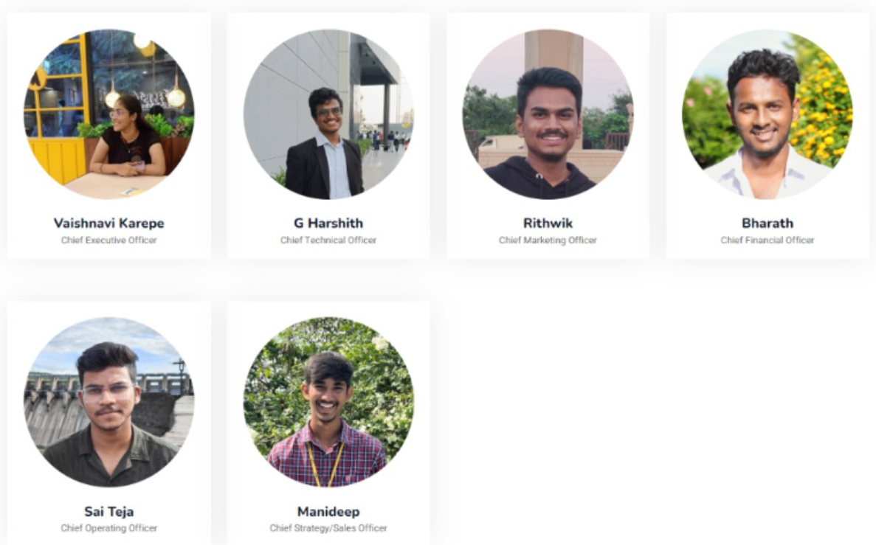
Team WingSpan

Slide 15
Conclusion: Building a Better Canteen Experience
In conclusion, the Canteen Management System (CMS) emerges as a transformative solution to the persistent challenges within the current campus dining landscape. The existing manual ordering system, characterized by never-ending lines and time wastage, becomes a thing of the past with the implementation of CMS. By seamlessly integrating advanced recommendation systems and innovative drone-based food delivery, CMS not only streamlines the ordering process but also addresses the crucial aspects of limited personalization and efficiency. This holistic approach promises to redefine the entire dining experience within the college community, marking a significant leap towards a more convenient, personalized, and technologically advanced canteen system.

Slide 16


